Slide 1
K-Means Clustering and Gaussian Mixture Model
Il-Chul Moon Dept. of Industrial and Systems Engineering KAIST
icmoon@kaist.ac.kr

Slide 2
Weekly Objectives
Understand the clustering task and the K-means algorithm
Know what the unsupervised learning is
Understand the K-means iterative process
Know the limitation of the K-means algorithm
Understand the Gaussian mixture model
Know the multinomial distribution and the multivariate Gaussian distribution
Know why mixture models are useful
Understand how the parameter updates are derived from the Gaussian mixture model
Understand the EM algorithm
Know the fundamentals of the EM algorithm
Know how to derive the EM updates of a model

Slide 3
K-Means algorithm

Slide 4
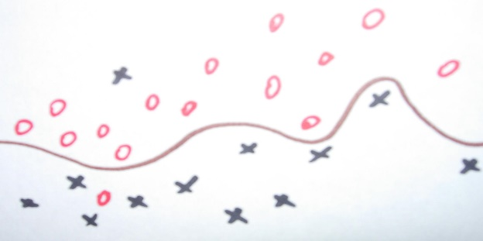
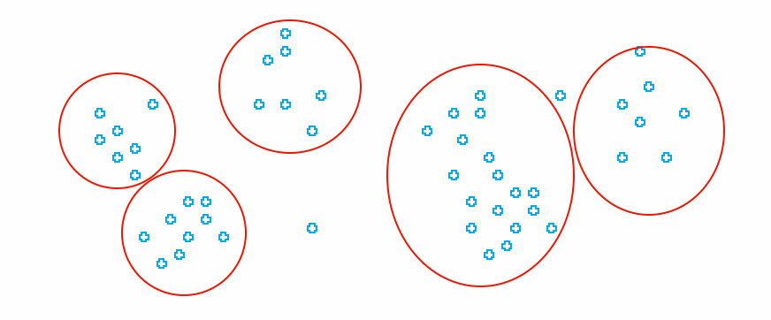
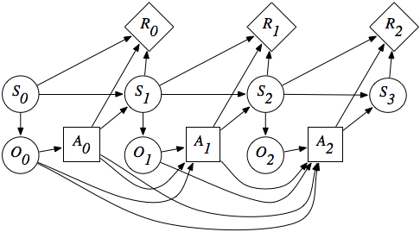
Types of Machine Learning
Machine Learning
…..
Supervised Learning
Unsupervised Learning
Reinforcement Learning
You know the true answers of some of instances
You do not know the true answers of instances
You do know the objective, but you do not know how to achieve
You can
Machine learning
Dataset provider
Machine learning users
etc
Various classifications by different professors
Purpose, data types, etc
Other learning classifications also exist

Slide 5
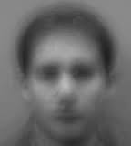
Unsupervised Learning
Unsupervised Learning
You do not know the true answers of instances
You don’t know the true value, and you cannot provide examples of the true value.
Cases, such as
Discovering clusters
Discovering latent factors
Discovering graph structures
Clustering or filtering or completing of
Finding the representative topic words from text data
Finding the latent image from facial data
Completing the incomplete matrix of product-review scores
Filtering the noise from the trajectory data
Methodologies
Clustering: estimating sets and affiliations of instances to the sets
Filtering: estimating underlying and fundamental signals from the mixture of signals and noises

Slide 6
Clustering Problem
How to assign data points to classes?
→ Clustering (here classes == clusters)
How to cluster the unlabeled data points?
No concrete knowledge of their classes
Latent (hidden) variable of classes
Optimal assignment to the latent classes
군집화의 불확실한 영역

Slide 7
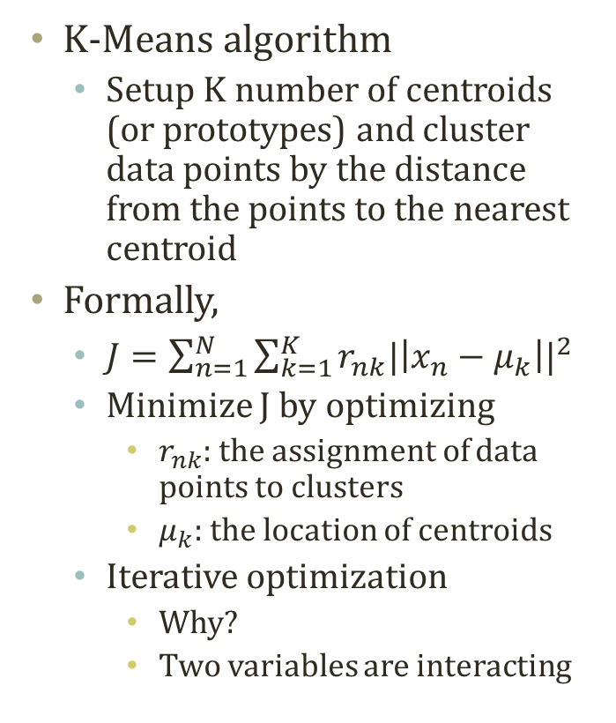
K-Means Algorithm
K-Means! = K-Neareat Neighbor
빨강 4개, 파랑 2개→ 빨강!
K-Means algorithm
Setup K number of centroids (or prototypes) and cluster data points by the distance from the points to the nearest centroid
Formally,
$J=\sum_{n=1}^{N}{\sum_{k=1}^{K}{r_{nk}{|\left|x_{n}−μ_{k}\right||}^{2}}}$
Minimize J by optimizing
$r_{nk}$: the assignment of data points to clusters
$μ_{k}$: the location of centroids
Iterative optimization
Why?
Two variables are interacting

Slide 8
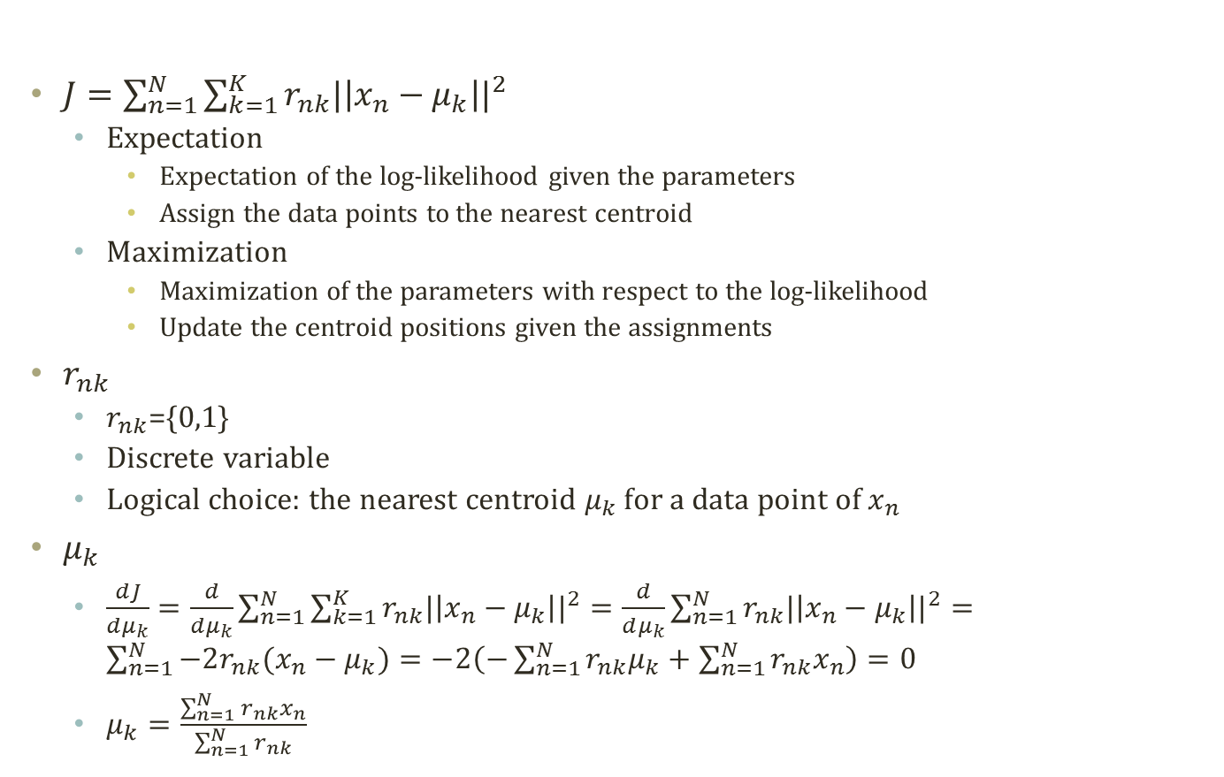
Expectation and Maximization
$J=\sum_{n=1}^{N}{\sum_{k=1}^{K}{r_{nk}{|\left|x_{n}−μ_{k}\right||}^{2}}}$
Expectation
Expectation of the log-likelihood given the parameters
Assign the data points to the nearest centroid
Maximization
Maximization of the parameters with respect to the log-likelihood
Update the centroid positions given the assignments
$r_{nk}$
$r_{nk}$={0,1}
Discrete variable
Logical choice: the nearest centroid $μ_{k}$ for a data point of $x_{n}$
$μ_{k}$
$\frac{dJ}{dμ_{k}}=\frac{d}{dμ_{k}}\sum_{n=1}^{N}{\sum_{k=1}^{K}{r_{nk}{|\left|x_{n}−μ_{k}\right||}^{2}}}=\frac{d}{dμ_{k}}\sum_{n=1}^{N}{r_{nk}{|\left|x_{n}−μ_{k}\right||}^{2}}=\sum_{n=1}^{N}{−2r_{nk}(x_{n}−μ_{k})}=−2\left(−\sum_{n=1}^{N}{r_{nk}μ_{k}}+\sum_{n=1}^{N}{r_{nk}x_{n}}\right)=0$
$μ_{k}=\frac{\sum_{n=1}^{N}{r_{nk}x_{n}}}{\sum_{n=1}^{N}{r_{nk}}}$

Slide 9
Progress of K-Means Algorithm
EM iterations to
Optimize the assignments with respect to the sum of distances
Optimize the parameters with respect to the sum of distances

Slide 10
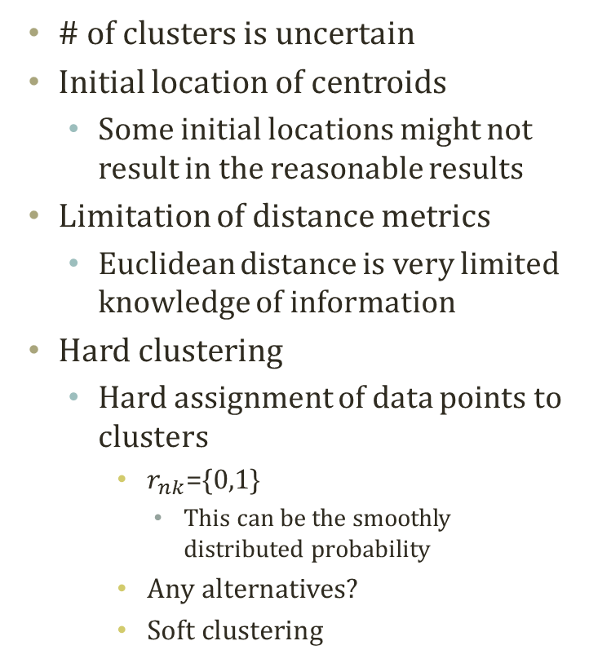
Properties of K-Means Algorithm
# of clusters is uncertain
Initial location of centroids
Some initial locations might not result in the reasonable results
Limitation of distance metrics
Euclidean distance is very limited knowledge of information
Hard clustering
Hard assignment of data points to clusters
$r_{nk}$={0,1}
This can be the smoothly distributed probability
Any alternatives?
Soft clustering

Slide 11
Gaussian mixture model

Slide 12
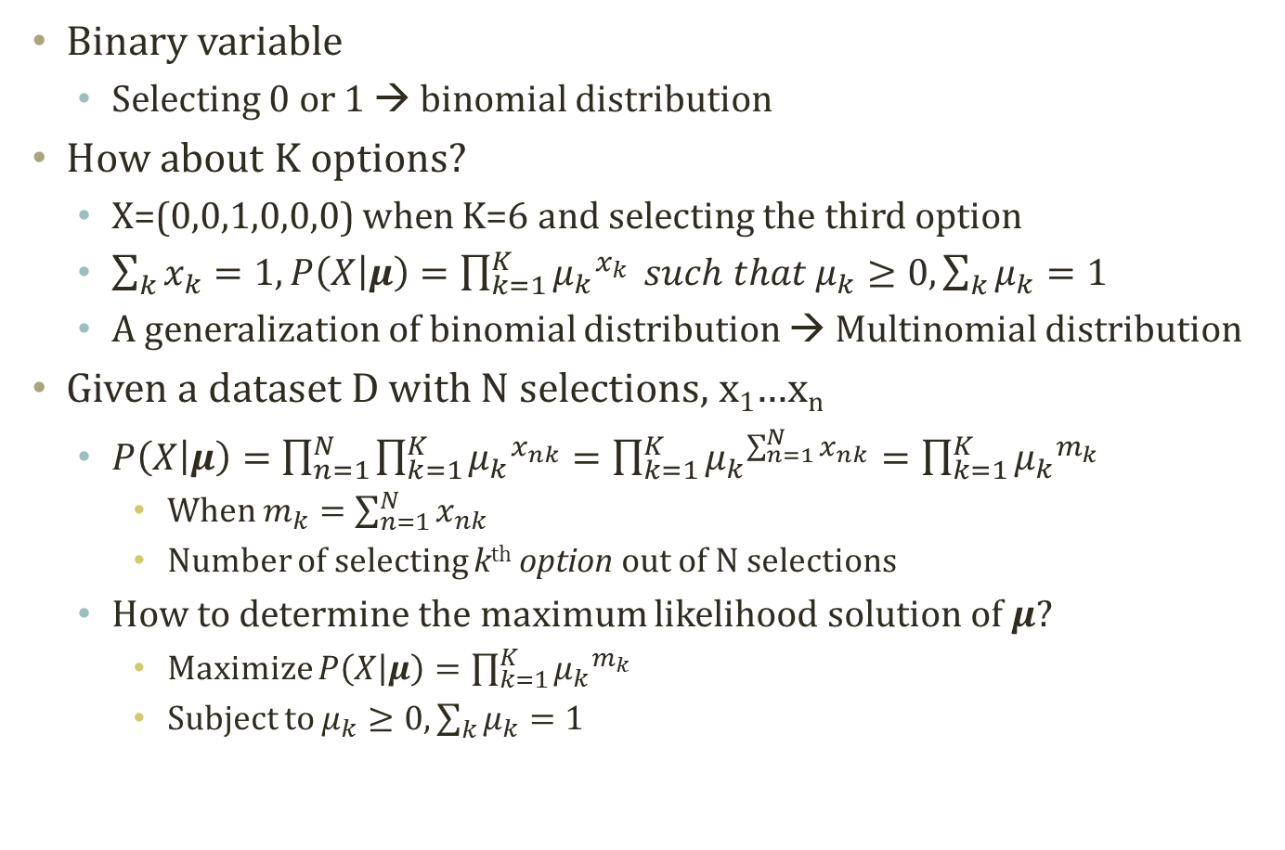
Multinomial Distribution
Binary variable
Selecting 0 or 1 → binomial distribution
How about K options?
X=(0,0,1,0,0,0) when K=6 and selecting the third option
$\sum_{k}{x_{k}}=1, P\left(X | μ\right)=\prod_{k=1}^{K}{{μ_{k}}^{x_{k}}} such that μ_{k}≥0,\sum_{k}{μ_{k}}=1$
A generalization of binomial distribution → Multinomial distribution
Given a dataset D with N selections, x₁…x_{n}
$P\left(X | μ\right)=\prod_{n=1}^{N}{\prod_{k=1}^{K}{{μ_{k}}^{x_{nk}}}}=\prod_{k=1}^{K}{{μ_{k}}^{\sum_{n=1}^{N}{x_{nk}}}}=\prod_{k=1}^{K}{{μ_{k}}^{m_{k}}}$
When $m_{k}=\sum_{n=1}^{N}{x_{nk}}$
Number of selecting k^{th} option out of N selections
How to determine the maximum likelihood solution of $μ$?
Maximize $P\left(X | μ\right)=\prod_{k=1}^{K}{{μ_{k}}^{m_{k}}}$
Subject to $μ_{k}≥0,\sum_{k}{μ_{k}}=1$

Slide 13
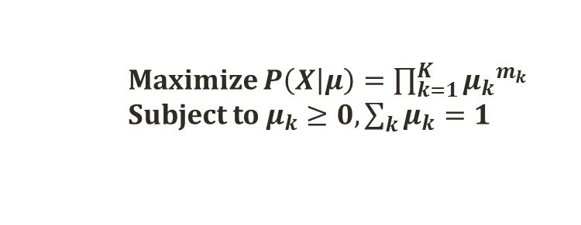
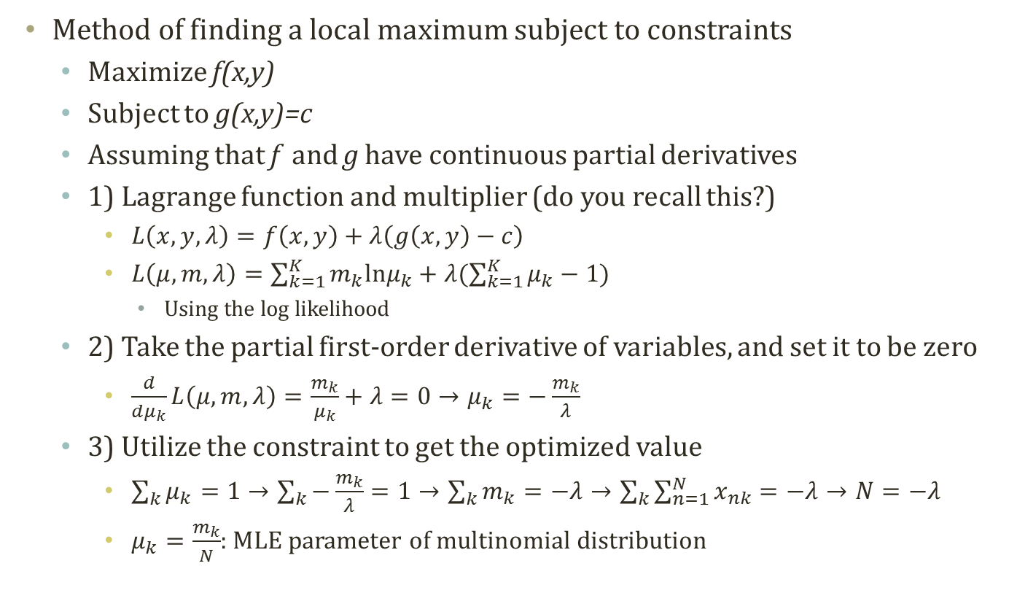
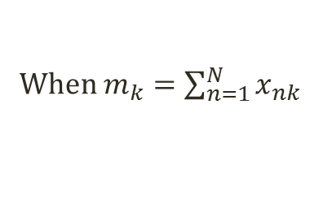
Lagrange Method
Maximize $P\left(X | μ\right)=\prod_{k=1}^{K}{{μ_{k}}^{m_{k}}}$
Subject to $μ_{k}≥0,\sum_{k}{μ_{k}}=1$
When $m_{k}=\sum_{n=1}^{N}{x_{nk}}$
Method of finding a local maximum subject to constraints
Maximize f(x,y)
Subject to g(x,y)=c
Assuming that f and g have continuous partial derivatives
1) Lagrange function and multiplier (do you recall this?)
$L\left(x,y,λ\right)=f\left(x,y\right)+λ\left(g\left(x,y\right)−c\right)$
$L\left(μ,m,λ\right)=\sum_{k=1}^{K}{m_{k}lnμ_{k}}+λ(\sum_{k=1}^{K}{μ_{k}}−1)$
Using the log likelihood
2) Take the partial first-order derivative of variables, and set it to be zero
$\frac{d}{dμ_{k}}L\left(μ,m,λ\right)=\frac{m_{k}}{μ_{k}}+λ=0→μ_{k}=−\frac{m_{k}}{λ}$
3) Utilize the constraint to get the optimized value
$\sum_{k}{μ_{k}}=1→\sum_{k}{−\frac{m_{k}}{λ}}=1→\sum_{k}{m_{k}}=−λ→\sum_{k}{\sum_{n=1}^{N}{x_{nk}}}=−λ→N=−λ$
$μ_{k}=\frac{m_{k}}{N}$: MLE parameter of multinomial distribution

Slide 14
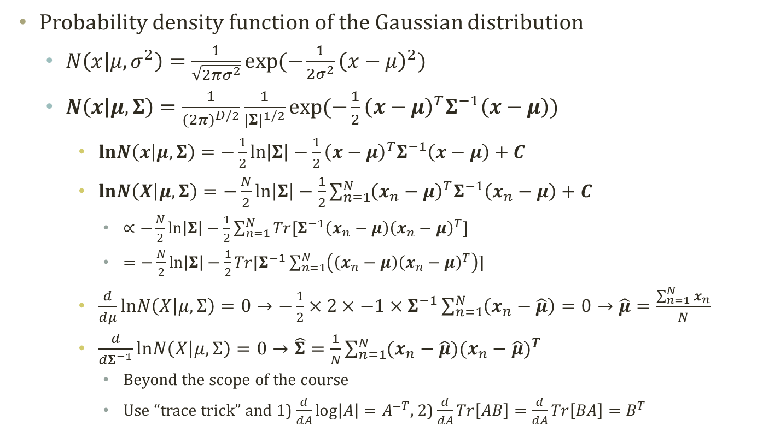
Multivariate Gaussian Distribution
Probability density function of the Gaussian distribution
$N\left(x | μ,σ^{2}\right)=\frac{1}{\sqrt{2πσ^{2}}}\exp{(−\frac{1}{2σ^{2}}{\left(x−μ\right)}^{2})}$
$N\left(x | μ,Σ\right)=\frac{1}{{(2π)}^{D/2}}\frac{1}{{|Σ|}^{1/2}}exp⁡(−\frac{1}{2}{\left(x−μ\right)}^{T}Σ^{−1}\left(x−μ\right))$
$lnN\left(x | μ,Σ\right)=−\frac{1}{2}\ln\left|Σ\right|−\frac{1}{2}{\left(x−μ\right)}^{T}Σ^{−1}\left(x−μ\right)+C$
$lnN\left(X | μ,Σ\right)=−\frac{N}{2}\ln\left|Σ\right|−\frac{1}{2}\sum_{n=1}^{N}{{\left(x_{n}−μ\right)}^{T}Σ^{−1}\left(x_{n}−μ\right)}+C$
$∝−\frac{N}{2}\ln\left|Σ\right|−\frac{1}{2}\sum_{n=1}^{N}{Tr[Σ^{−1}\left(x_{n}−μ\right){\left(x_{n}−μ\right)}^{T}]}$
$=−\frac{N}{2}\ln\left|Σ\right|−\frac{1}{2}Tr[Σ^{−1}\sum_{n=1}^{N}{\left(\left(x_{n}−μ\right){\left(x_{n}−μ\right)}^{T}\right)}]$
$\frac{d}{dμ}lnN\left(X | μ,Σ\right)=0→−\frac{1}{2}×2×−1×Σ^{−1}\sum_{n=1}^{N}{\left(x_{n}−\hat{μ}\right)}=0→\hat{μ}=\frac{\sum_{n=1}^{N}{x_{n}}}{N}$
$\frac{d}{dΣ^{−1}}lnN\left(X | μ,Σ\right)=0→\hat{Σ}=\frac{1}{N}\sum_{n=1}^{N}{(x_{n}−\hat{μ}){(x_{n}−\hat{μ})}^{T}}$
Beyond the scope of the course
Use “trace trick” and 1) $\frac{d}{dA}\log\left|A\right|=A^{−T}$, 2) $\frac{d}{dA}Tr\left[AB\right]=\frac{d}{dA}Tr\left[BA\right]=B^{T}$

Slide 15



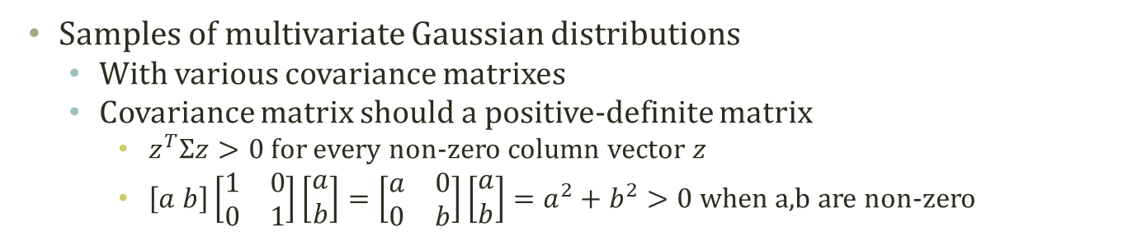





Samples of Multivariate Gaussian Distribution
Samples of multivariate Gaussian distributions
With various covariance matrixes
Covariance matrix should a positive-definite matrix
$z^{T}Σz>0$for every non-zero column vector $z$
$\left[a b\right]\left[\begin{matrix}1 & 0 \\ 0 & 1\end{matrix}\right]\left[\begin{matrix}a \\ b\end{matrix}\right]=\left[\begin{matrix}a & 0 \\ 0 & b\end{matrix}\right]\left[\begin{matrix}a \\ b\end{matrix}\right]=a^{2}+b^{2}>0$ when a,b are non-zero
$$\left[\begin{matrix}5 & 0 \\ 0 & 1\end{matrix}\right]$$
$$\left[\begin{matrix}1 & 0 \\ 0 & 5\end{matrix}\right]$$
$$\left[\begin{matrix}0 & 0 \\ 0 & 0\end{matrix}\right]$$
$$\left[\begin{matrix}1 & 0 \\ 0 & 0\end{matrix}\right]$$
$$\left[\begin{matrix}2 & 1 \\ 1 & 2\end{matrix}\right]$$
$$\left[\begin{matrix}1 & 0 \\ 0 & 1\end{matrix}\right]$$
$$\left[\begin{matrix}1 & 1 \\ 1 & 1\end{matrix}\right]$$
$$\left[\begin{matrix}2 & −1 \\ −1 & 2\end{matrix}\right]$$

Slide 16
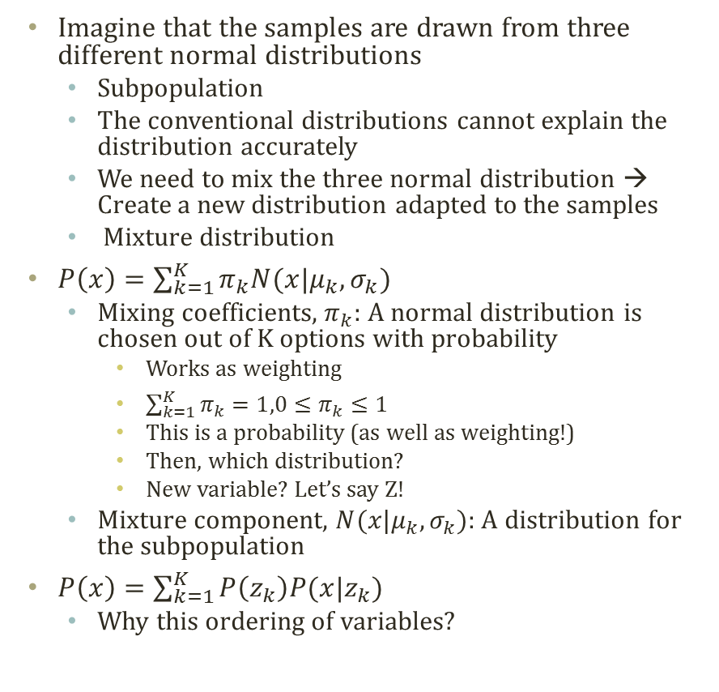
Mixture Model
Imagine that the samples are drawn from three different normal distributions
Subpopulation
The conventional distributions cannot explain the distribution accurately
We need to mix the three normal distribution → Create a new distribution adapted to the samples
Mixture distribution
$P\left(x\right)=\sum_{k=1}^{K}{π_{k}N(x|μ_{k},σ_{k})}$
Mixing coefficients, $π_{k}$: A normal distribution is chosen out of K options with probability
Works as weighting
$\sum_{k=1}^{K}{π_{k}}=1,0≤π_{k}≤1$
This is a probability (as well as weighting!)
Then, which distribution?
New variable? Let’s say Z!
Mixture component, $N(x|μ_{k},σ_{k})$: A distribution for the subpopulation
$P\left(x\right)=\sum_{k=1}^{K}{P\left(z_{k}\right)P(x|z_{k}) }$
Why this ordering of variables?

Slide 17

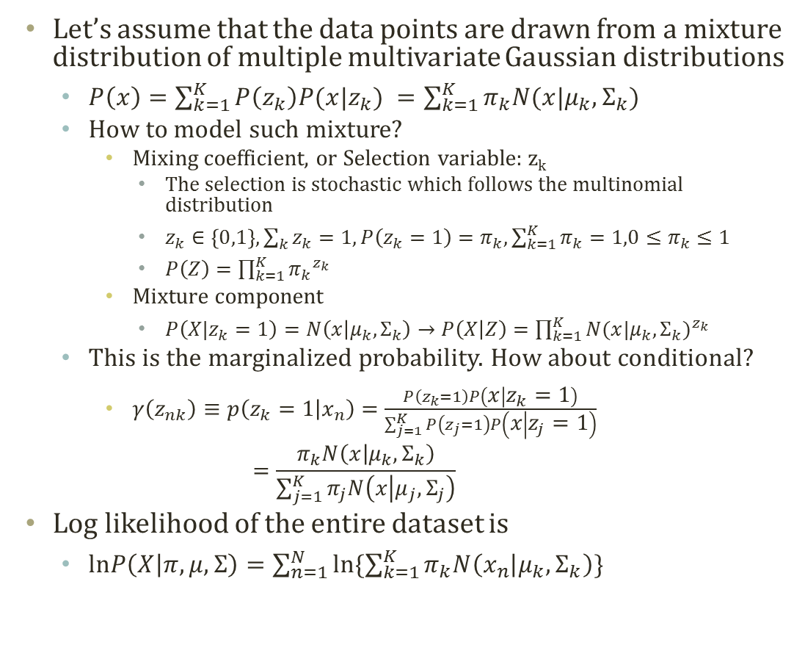


Gaussian Mixture Model
Let’s assume that the data points are drawn from a mixture distribution of multiple multivariate Gaussian distributions
$P\left(x\right)=\sum_{k=1}^{K}{P\left(z_{k}\right)P(x|z_{k}) }=\sum_{k=1}^{K}{π_{k}N(x|μ_{k},Σ_{k})}$
How to model such mixture?
Mixing coefficient, or Selection variable: z_{k}
The selection is stochastic which follows the multinomial distribution
$z_{k}∈\left\{0,1\right\}, \sum_{k}{z_{k}}=1, P\left(z_{k}=1\right)=π_{k},\sum_{k=1}^{K}{π_{k}}=1,0≤π_{k}≤1$
$P\left(Z\right)=\prod_{k=1}^{K}{{π_{k}}^{z_{k}}}$
Mixture component
$P\left(X|z_{k}=1\right)=N\left(x | μ_{k},Σ_{k}\right)→P\left(X | Z\right)=\prod_{k=1}^{K}{{N(x|μ_{k},Σ_{k})}^{z_{k}}}$
This is the marginalized probability. How about conditional?
$γ\left(z_{nk}\right)≡p\left(z_{k}=1 | x_{n}\right)=\frac{P\left(z_{k}=1\right)P\left(x | z_{k}=1\right)}{\sum_{j=1}^{K}{P\left(z_{j}=1\right)P\left(x | z_{j}=1\right)}}$ $=\frac{π_{k}N\left(x | μ_{k},Σ_{k}\right)}{\sum_{j=1}^{K}{π_{j}N\left(x | μ_{j},Σ_{j}\right)}}$
Log likelihood of the entire dataset is
$lnP\left(X | π,μ,Σ\right)=\sum_{n=1}^{N}{ln\{\sum_{k=1}^{K}{π_{k}N\left(x_{n} | μ_{k},Σ_{k}\right)}\}}$
$$π$$
Z
$$μ$$
$$Σ$$
X
N

Slide 18
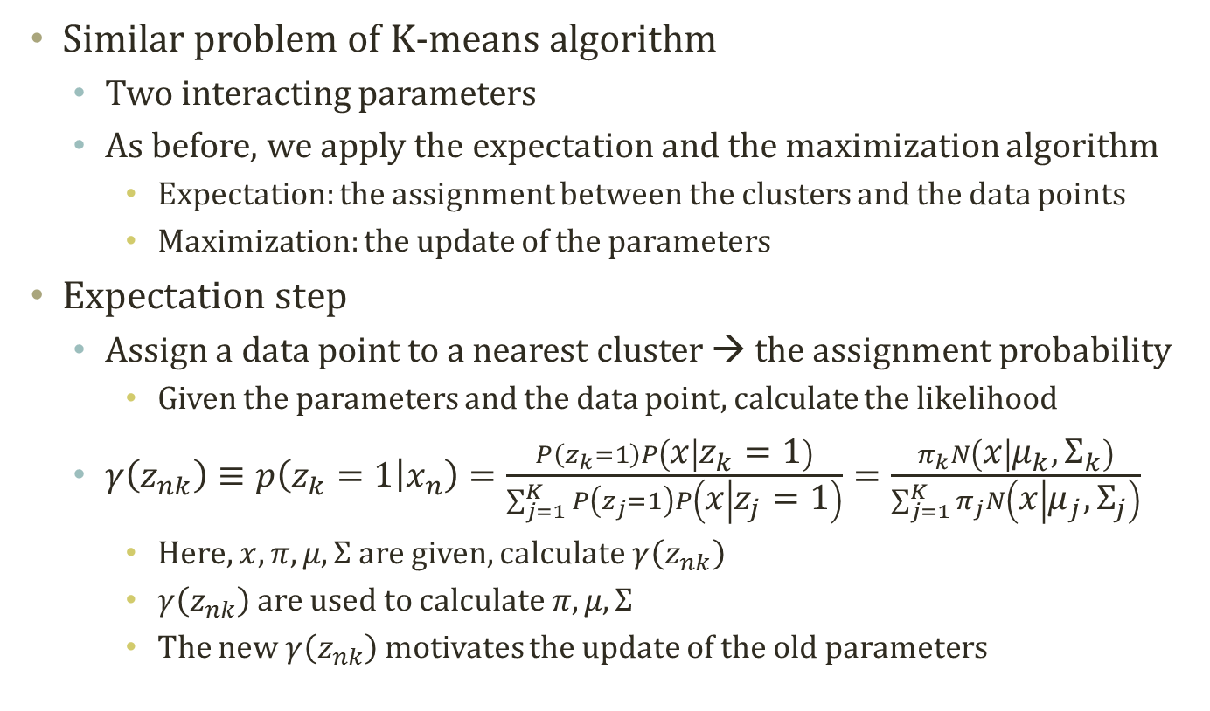
Expectation of GMM
Similar problem of K-means algorithm
Two interacting parameters
As before, we apply the expectation and the maximization algorithm
Expectation: the assignment between the clusters and the data points
Maximization: the update of the parameters
Expectation step
Assign a data point to a nearest cluster → the assignment probability
Given the parameters and the data point, calculate the likelihood
$γ\left(z_{nk}\right)≡p\left(z_{k}=1 | x_{n}\right)=\frac{P\left(z_{k}=1\right)P\left(x | z_{k}=1\right)}{\sum_{j=1}^{K}{P\left(z_{j}=1\right)P\left(x | z_{j}=1\right)}}=\frac{π_{k}N\left(x | μ_{k},Σ_{k}\right)}{\sum_{j=1}^{K}{π_{j}N\left(x | μ_{j},Σ_{j}\right)}}$
Here, $x,π,μ, Σ$ are given, calculate $γ\left(z_{nk}\right)$
$γ\left(z_{nk}\right)$ are used to calculate $π,μ, Σ$
The new $γ\left(z_{nk}\right)$ motivates the update of the old parameters

Slide 19
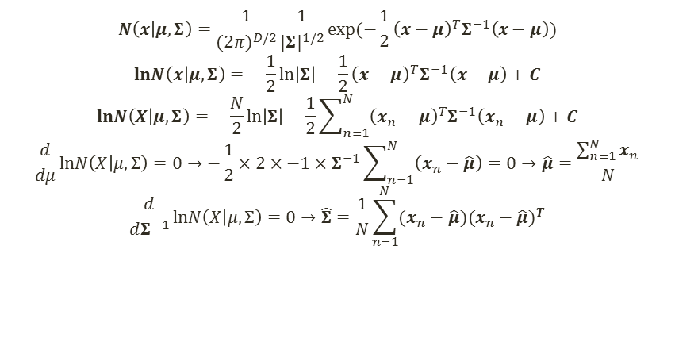
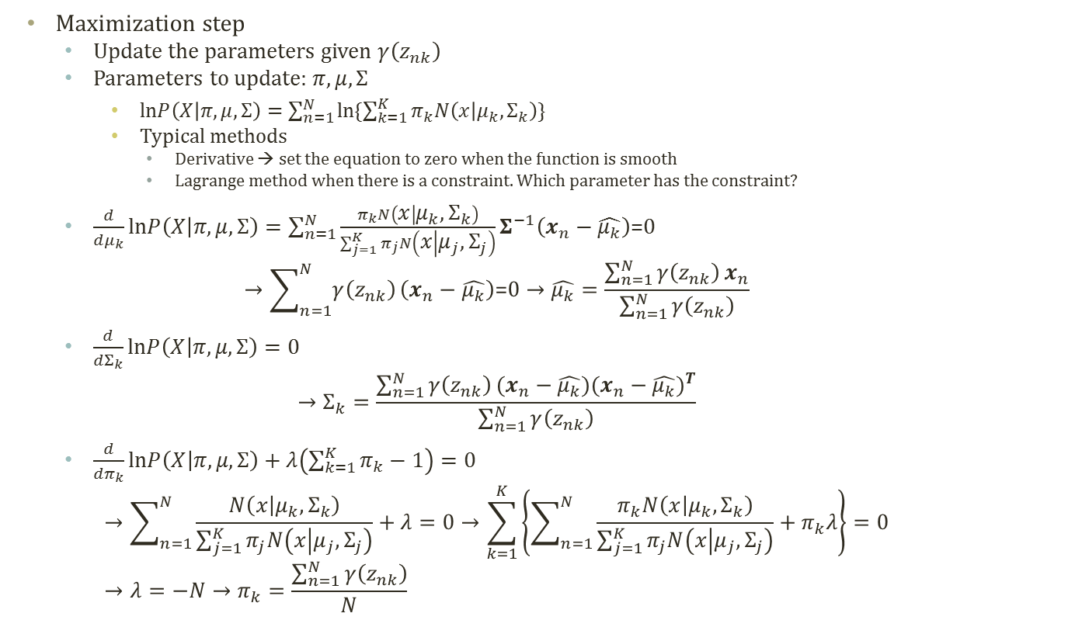

Maximization of GMM
$$N\left(x | μ,Σ\right)=\frac{1}{{(2π)}^{D/2}}\frac{1}{{|Σ|}^{1/2}}exp⁡(−\frac{1}{2}{\left(x−μ\right)}^{T}Σ^{−1}\left(x−μ\right))$$
$$lnN\left(x | μ,Σ\right)=−\frac{1}{2}\ln\left|Σ\right|−\frac{1}{2}{\left(x−μ\right)}^{T}Σ^{−1}\left(x−μ\right)+C$$
$$lnN\left(X | μ,Σ\right)=−\frac{N}{2}\ln\left|Σ\right|−\frac{1}{2}\sum_{n=1}^{N}{{\left(x_{n}−μ\right)}^{T}Σ^{−1}\left(x_{n}−μ\right)}+C$$
$$\frac{d}{dμ}lnN\left(X | μ,Σ\right)=0→−\frac{1}{2}×2×−1×Σ^{−1}\sum_{n=1}^{N}{\left(x_{n}−\hat{μ}\right)}=0→\hat{μ}=\frac{\sum_{n=1}^{N}{x_{n}}}{N}$$
$$\frac{d}{dΣ^{−1}}lnN\left(X | μ,Σ\right)=0→\hat{Σ}=\frac{1}{N}\sum_{n=1}^{N}{(x_{n}−\hat{μ}){(x_{n}−\hat{μ})}^{T}}$$
Maximization step
Update the parameters given $γ\left(z_{nk}\right)$
Parameters to update: $π,μ, Σ$
$lnP\left(X | π,μ,Σ\right)=\sum_{n=1}^{N}{ln\{\sum_{k=1}^{K}{π_{k}N\left(x | μ_{k},Σ_{k}\right)}\}}$
Typical methods
Derivative → set the equation to zero when the function is smooth
Lagrange method when there is a constraint. Which parameter has the constraint?
$\frac{d}{dμ_{k}}lnP\left(X | π,μ,Σ\right)=\sum_{n=1}^{N}{\frac{π_{k}N\left(x | μ_{k},Σ_{k}\right)}{\sum_{j=1}^{K}{π_{j}N\left(x | μ_{j},Σ_{j}\right)}}}Σ^{−1}\left(x_{n}−\hat{μ_{k}}\right)\text{=0}$ $→\sum_{n=1}^{N}{γ\left(z_{nk}\right)}\left(x_{n}−\hat{μ_{k}}\right)\text{=0}→\hat{μ_{k}}=\frac{\sum_{n=1}^{N}{γ\left(z_{nk}\right)}x_{n}}{\sum_{n=1}^{N}{γ\left(z_{nk}\right)}}$
$\frac{d}{dΣ_{k}}lnP\left(X | π,μ,Σ\right)=0$ $→Σ_{k}=\frac{\sum_{n=1}^{N}{γ\left(z_{nk}\right)}(x_{n}−\hat{μ_{k}}){(x_{n}−\hat{μ_{k}})}^{T}}{\sum_{n=1}^{N}{γ\left(z_{nk}\right)}}$
$\frac{d}{dπ_{k}}lnP\left(X | π,μ,Σ\right)+λ\left(\sum_{k=1}^{K}{π_{k}}−1\right)=0$ $→\sum_{n=1}^{N}{\frac{N\left(x | μ_{k},Σ_{k}\right)}{\sum_{j=1}^{K}{π_{j}N\left(x | μ_{j},Σ_{j}\right)}}}+λ=0→\sum_{k=1}^{K}{\left\{\sum_{n=1}^{N}{\frac{π_{k}N\left(x | μ_{k},Σ_{k}\right)}{\sum_{j=1}^{K}{π_{j}N\left(x | μ_{j},Σ_{j}\right)}}}+π_{k}λ\right\}}=0$ $→λ=−N→π_{k}=\frac{\sum_{n=1}^{N}{γ\left(z_{nk}\right)}}{N}$
$$γ\left(z_{nk}\right)=\frac{π_{k}N\left(x | μ_{k},Σ_{k}\right)}{\sum_{j=1}^{K}{π_{j}N\left(x | μ_{j},Σ_{j}\right)}}$$

Slide 20
Progress of GMM
Soft clustering
Estimated parameters
Soft assignment of data points to clusters

Slide 21
Properties of GMM
K-Means Algorithm
Pros and cons of Gaussian mixture model
Pros
More information
Soft clustering
Not a simple and discrete assignment
Information loss
More and more information
Learn the latent distribution
Distance is not always the answer of the distribution
Cons
Long computation time
Why?
Falling into local maximum
Deciding K
Anyways to mitigate the disadvantage?
Fast K-means and slow GMM
Gaussian Mixture Model

Slide 22
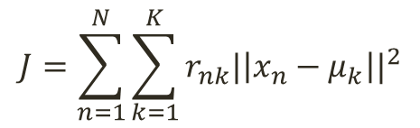
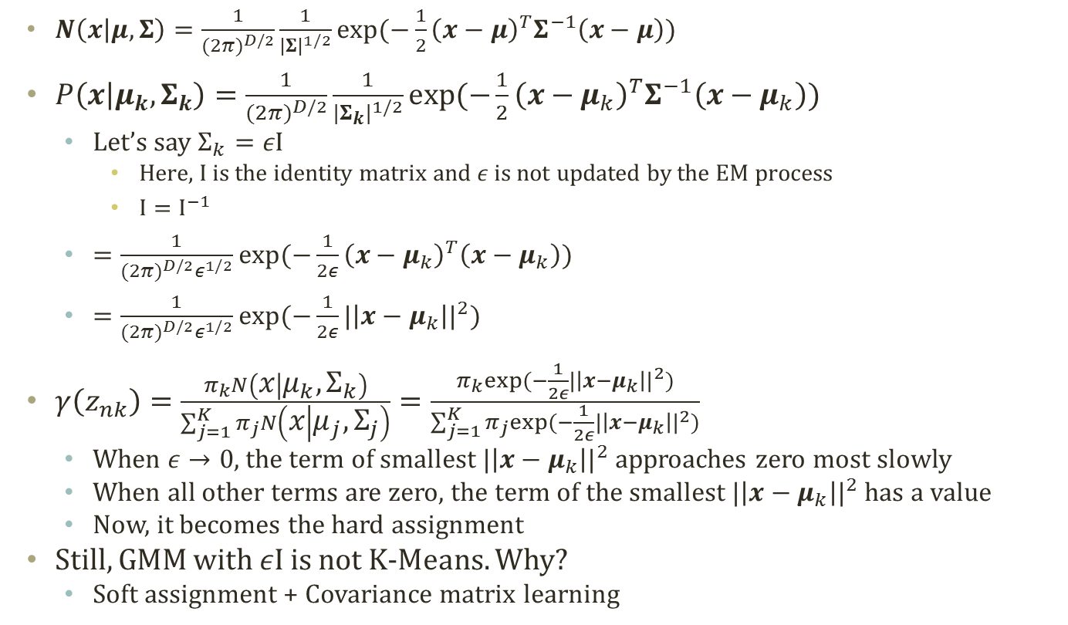
Relation between K-Means and GMM
$N\left(x | μ,Σ\right)=\frac{1}{{(2π)}^{D/2}}\frac{1}{{|Σ|}^{1/2}}exp⁡(−\frac{1}{2}{\left(x−μ\right)}^{T}Σ^{−1}\left(x−μ\right))$
$P\left(x | μ_{k}, Σ_{k}\right)=\frac{1}{{(2π)}^{D/2}}\frac{1}{{|Σ_{k}|}^{1/2}}exp⁡(−\frac{1}{2}{\left(x−μ_{k}\right)}^{T}Σ^{−1}\left(x−μ_{k}\right))$
Let’s say $Σ_{k}=εΙ$
Here, I is the identity matrix and $ε$ is not updated by the EM process
$Ι=Ι^{−1}$
$=\frac{1}{{(2π)}^{D/2}ε^{1/2}}exp⁡(−\frac{1}{2ε}{\left(x−μ_{k}\right)}^{T}\left(x−μ_{k}\right))$
$=\frac{1}{{(2π)}^{D/2}ε^{1/2}}exp⁡(−\frac{1}{2ε}{|\left|x−μ_{k}\right||}^{2})$
$γ\left(z_{nk}\right)=\frac{π_{k}N\left(x | μ_{k},Σ_{k}\right)}{\sum_{j=1}^{K}{π_{j}N\left(x | μ_{j},Σ_{j}\right)}}=\frac{π_{k}exp⁡(−\frac{1}{2ε}{|\left|x−μ_{k}\right||}^{2})}{\sum_{j=1}^{K}{π_{j}exp⁡(−\frac{1}{2ε}{|\left|x−μ_{k}\right||}^{2})}}$
When $ε→0$, the term of smallest ${|\left|x−μ_{k}\right||}^{2}$ approaches zero most slowly
When all other terms are zero, the term of the smallest ${|\left|x−μ_{k}\right||}^{2}$ has a value
Now, it becomes the hard assignment
Still, GMM with $εΙ$ is not K-Means. Why?
Soft assignment + Covariance matrix learning
$$J=\sum_{n=1}^{N}{\sum_{k=1}^{K}{r_{nk}{|\left|x_{n}−μ_{k}\right||}^{2}}}$$
K-Means Algorithm

Slide 23
EM algorithm

Slide 24
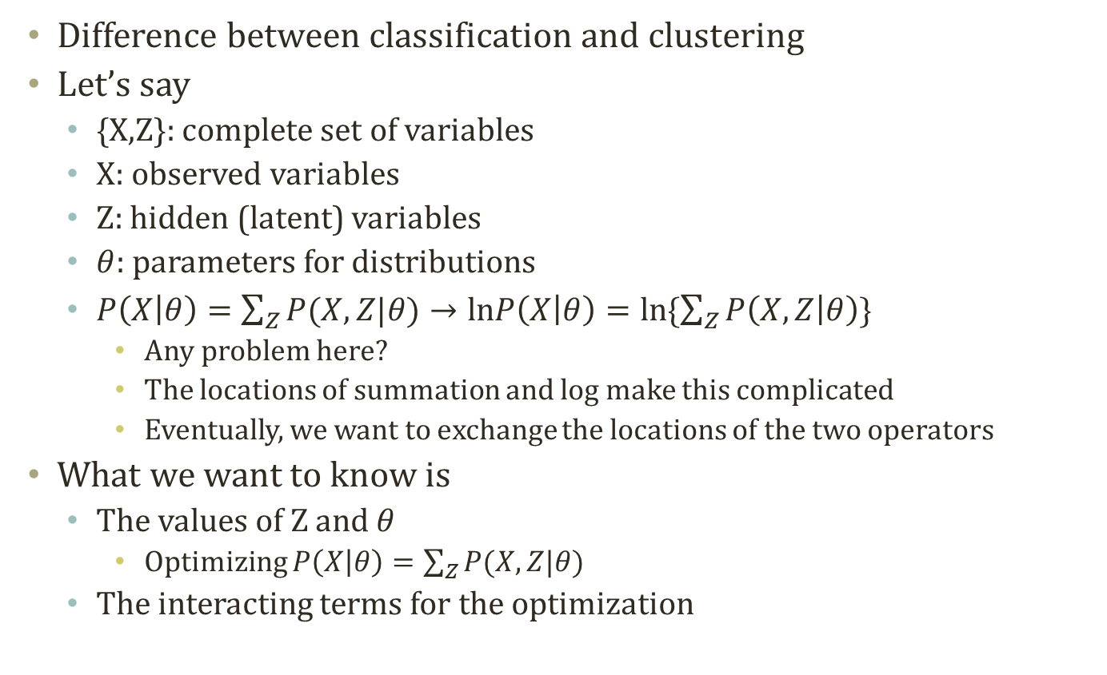
Inference with Latent Variables
Difference between classification and clustering
Let’s say
{X,Z}: complete set of variables
X: observed variables
Z: hidden (latent) variables
$θ$: parameters for distributions
$P\left(X | θ\right)=\sum_{Z}{P(X,Z|θ)}→lnP\left(X | θ\right)=ln\{\sum_{Z}{P\left(X,Z | θ\right)}\}$
Any problem here?
The locations of summation and log make this complicated
Eventually, we want to exchange the locations of the two operators
What we want to know is
The values of Z and $θ$
Optimizing $P\left(X | θ\right)=\sum_{Z}{P(X,Z|θ)}$
The interacting terms for the optimization

Slide 25
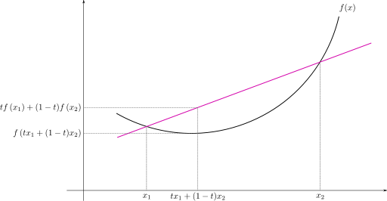
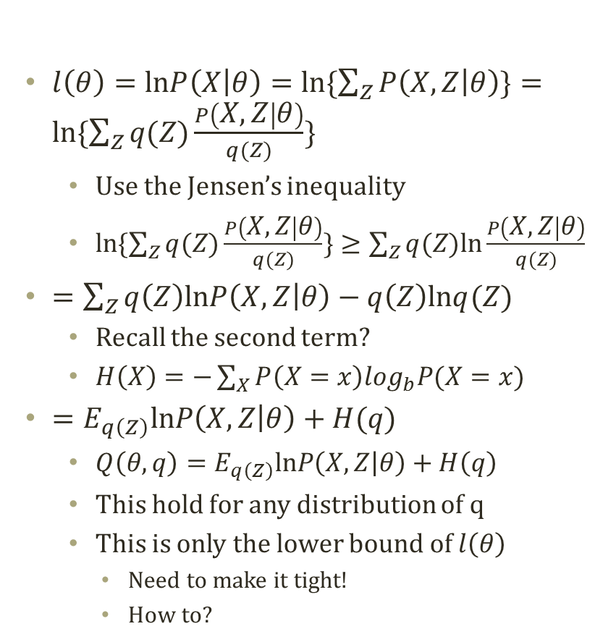
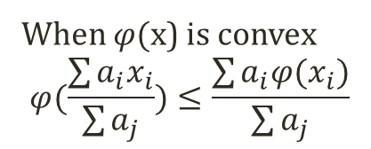
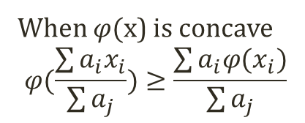
Probability Decomposition
$l\left(θ\right)=lnP\left(X | θ\right)=ln\{\sum_{Z}{P\left(X,Z | θ\right)}\}=ln\{\sum_{Z}{q(Z)\frac{P\left(X,Z | θ\right)}{q(Z)}}\}$
Use the Jensen’s inequality
$ln\{\sum_{Z}{q(Z)\frac{P\left(X,Z | θ\right)}{q(Z)}}\}≥\sum_{Z}{q(Z)ln\frac{P\left(X,Z | θ\right)}{q(Z)}}$
$=\sum_{Z}{q\left(Z\right)lnP\left(X,Z | θ\right)−q\left(Z\right)lnq(Z)}$
Recall the second term?
$H\left(X\right)=−\sum_{X}{P\left(X=x\right)\log_{b}P(X=x)}$
$=E_{q\left(Z\right)}lnP\left(X,Z | θ\right)+H(q)$
$Q\left(θ,q\right)=E_{q\left(Z\right)}lnP\left(X,Z | θ\right)+H\left(q\right)$
This hold for any distribution of q
This is only the lower bound of $l\left(θ\right)$
Need to make it tight!
How to?
Jensen’s Inequality
When $φ($x) is concave
$$φ(\frac{\sum{a_{i}x_{i}}}{\sum{a_{j}}})≥\frac{\sum{a_{i}φ(x_{i}})}{\sum{a_{j}}}$$
When $φ($x) is convex
$$φ(\frac{\sum{a_{i}x_{i}}}{\sum{a_{j}}})≤\frac{\sum{a_{i}φ(x_{i}})}{\sum{a_{j}}}$$

Slide 26
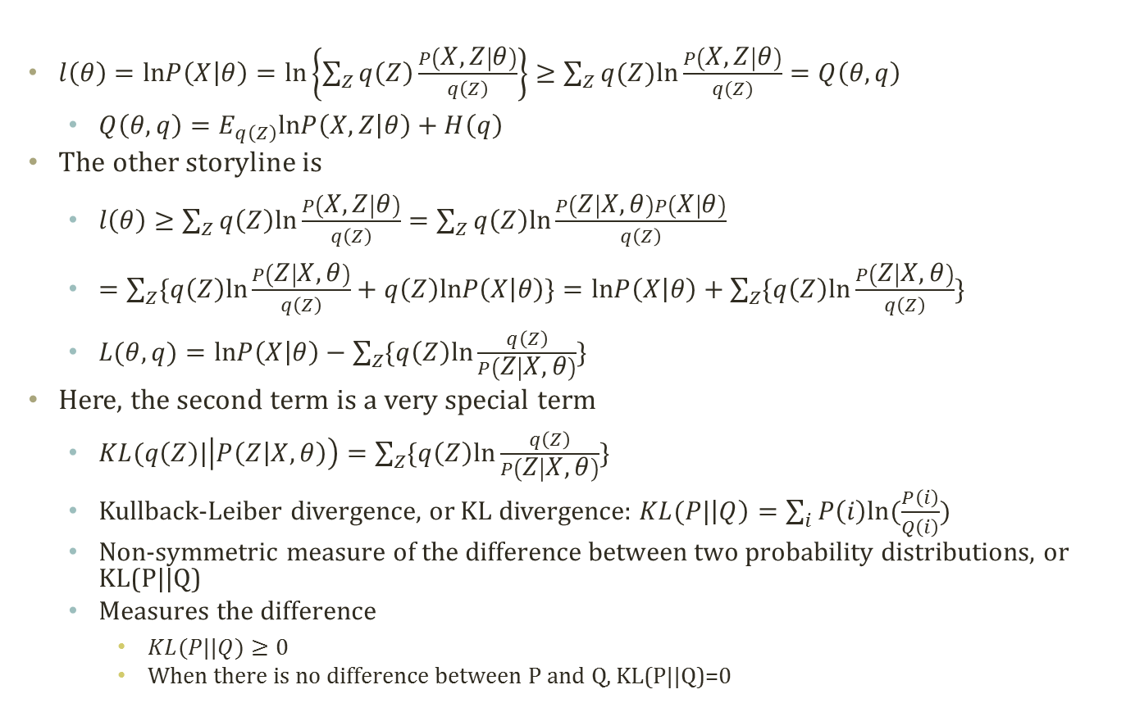
Maximizing the Lower Bound (1)
$l\left(θ\right)=lnP\left(X | θ\right)=ln\left\{\sum_{Z}{q\left(Z\right)\frac{P\left(X,Z | θ\right)}{q\left(Z\right)}}\right\}≥\sum_{Z}{q(Z)ln\frac{P\left(X,Z | θ\right)}{q(Z)}}=Q\left(θ,q\right)$
$Q\left(θ,q\right)=E_{q\left(Z\right)}lnP\left(X,Z | θ\right)+H\left(q\right)$
The other storyline is
$l\left(θ\right)≥\sum_{Z}{q\left(Z\right)ln\frac{P\left(X,Z | θ\right)}{q\left(Z\right)}}=\sum_{Z}{q\left(Z\right)ln\frac{P\left(Z | X,θ\right)P\left(X | θ\right)}{q\left(Z\right)}}$
$=\sum_{Z}{\{q\left(Z\right)ln\frac{P\left(Z | X,θ\right)}{q\left(Z\right)}+q\left(Z\right)lnP\left(X | θ\right)\}}=lnP\left(X | θ\right)+\sum_{Z}{\{q\left(Z\right)ln\frac{P\left(Z | X,θ\right)}{q\left(Z\right)}\}}$
$L(θ,q)=lnP\left(X | θ\right)−\sum_{Z}{\{q\left(Z\right)ln\frac{q\left(Z\right)}{P\left(Z | X,θ\right)}\}}$
Here, the second term is a very special term
$KL(q\left(Z\right)|\left|P\left(Z | X,θ\right)\right)=\sum_{Z}{\{q\left(Z\right)ln\frac{q\left(Z\right)}{P\left(Z | X,θ\right)}\}}$
Kullback-Leiber divergence, or KL divergence: $KL(P|\left|Q\right)=\sum_{i}{P\left(i\right)ln⁡(\frac{P\left(i\right)}{Q\left(i\right)})}$
Non-symmetric measure of the difference between two probability distributions, or KL(P||Q)
Measures the difference
$KL(P||Q)≥0$
When there is no difference between P and Q, KL(P||Q)=0

Slide 27
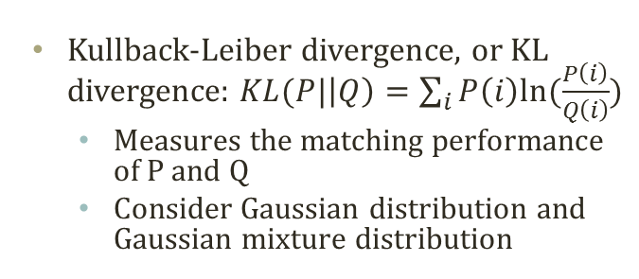
KL Divergence
Distribution Q2
Kullback-Leiber divergence, or KL divergence: $KL(P|\left|Q\right)=\sum_{i}{P\left(i\right)ln⁡(\frac{P\left(i\right)}{Q\left(i\right)})}$
Measures the matching performance of P and Q
Consider Gaussian distribution and Gaussian mixture distribution
KL(P||Q2)=0.0104
KL(Q2||P)=0.0101
Distribution P
Distribution Q1
KL(P||Q1)=0.5440
KL(Q1||P)=0.9835

Slide 28

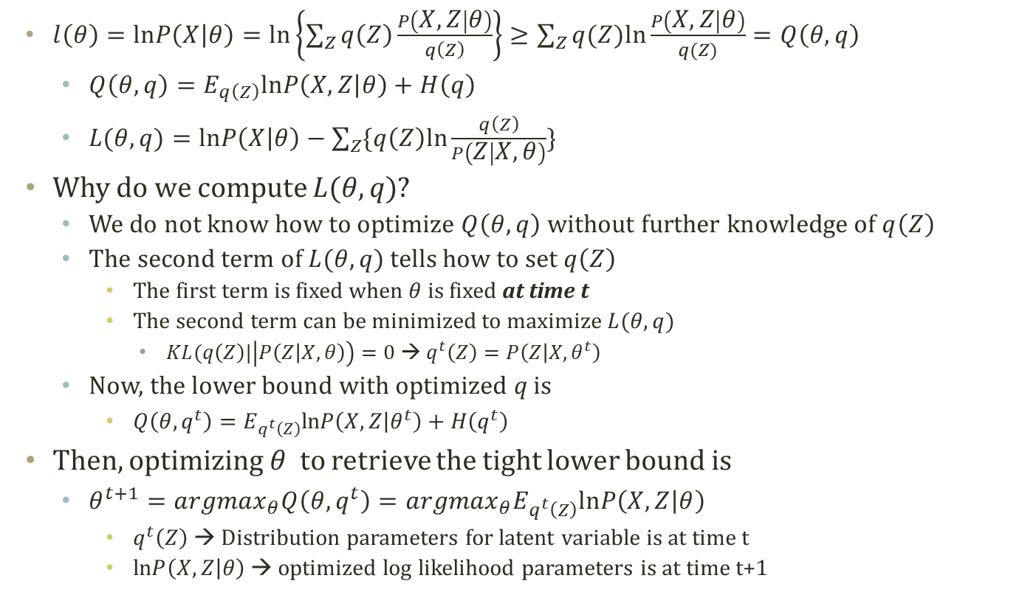

Maximizing the Lower Bound (2)
$l\left(θ\right)=lnP\left(X | θ\right)=ln\left\{\sum_{Z}{q\left(Z\right)\frac{P\left(X,Z | θ\right)}{q\left(Z\right)}}\right\}≥\sum_{Z}{q(Z)ln\frac{P\left(X,Z | θ\right)}{q(Z)}}=Q\left(θ,q\right)$
$Q\left(θ,q\right)=E_{q\left(Z\right)}lnP\left(X,Z | θ\right)+H\left(q\right)$
$L(θ,q)=lnP\left(X | θ\right)−\sum_{Z}{\{q\left(Z\right)ln\frac{q\left(Z\right)}{P\left(Z | X,θ\right)}\}}$
Why do we compute $L(θ,q)$?
We do not know how to optimize $Q\left(θ,q\right)$ without further knowledge of $q\left(Z\right)$
The second term of $L(θ,q)$ tells how to set $q\left(Z\right)$
The first term is fixed when $θ$ is fixed at time t
The second term can be minimized to maximize $L(θ,q)$
$KL(q\left(Z\right)|\left|P\left(Z | X,θ\right)\right)=0$ → $q^{t}\left(Z\right)=P\left(Z | X, θ^{t}\right)$
Now, the lower bound with optimized q is
$Q\left(θ,q^{t}\right)=E_{q^{t}\left(Z\right)}lnP\left(X,Z | θ^{t}\right)+H\left(q^{t}\right)$
Then, optimizing $θ$ to retrieve the tight lower bound is
$θ^{t+1}={argmax}_{θ}Q\left(θ,q^{t}\right)={argmax}_{θ}E_{q^{t}\left(Z\right)}lnP\left(X,Z | θ\right)$
$q^{t}\left(Z\right)$ → Distribution parameters for latent variable is at time t
$lnP\left(X,Z | θ\right)$ → optimized log likelihood parameters is at time t+1
Tells how to setup Z
by setting $q^{t}\left(Z\right)=P\left(Z | X, θ^{t}\right)$
Relax the KL divergence by updating $θ^{t}$ to $θ^{t+1}$

Slide 29
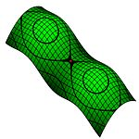



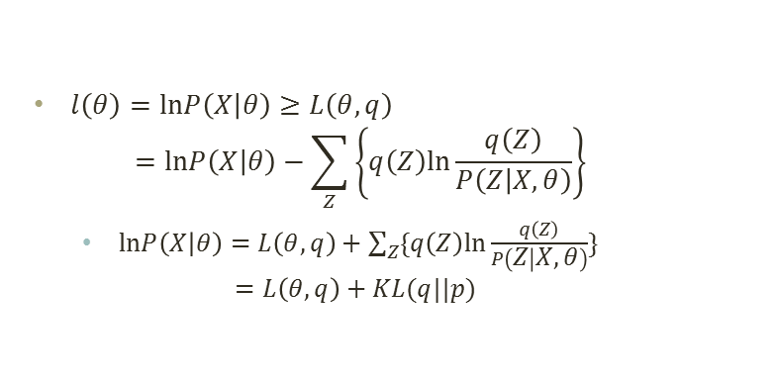











Graphical Interpretation of Lower Bound Maximization
$$q$$
지역 최적해?
$l\left(θ\right)=lnP\left(X | θ\right)≥L\left(θ,q\right)$ $=lnP\left(X | θ\right)−\sum_{Z}{\left\{q\left(Z\right)ln\frac{q\left(Z\right)}{P\left(Z | X,θ\right)}\right\}}$
$lnP\left(X | θ\right)=L\left(θ,q\right)+\sum_{Z}{\{q\left(Z\right)ln\frac{q\left(Z\right)}{P\left(Z | X,θ\right)}\}}$ $=L\left(θ,q\right)+KL(q||p)$
안장점?
$$θ$$
$$KL(q|\left|p\right)$$
$$KL(q|\left|p\right)=0$$
$$KL(q||p)$$
최적의 q
최$적의 θ$
$$lnP\left(X | θ^{t}\right)$$
$$lnP\left(X | θ^{t}\right)$$
$$lnP\left(X | θ^{t+1}\right)$$
$$L\left(θ^{t},q\right)$$
$$L\left(θ^{t},q^{t}\right)$$
$$L\left(θ^{t+1},q^{t}\right)$$
$$q^{t}\left(Z\right)=P\left(Z | X, θ^{t}\right)$$
$$θ^{t+1}={argmax}_{θ}E_{q^{t}\left(Z\right)}lnP\left(X,Z | θ\right)$$

Slide 30
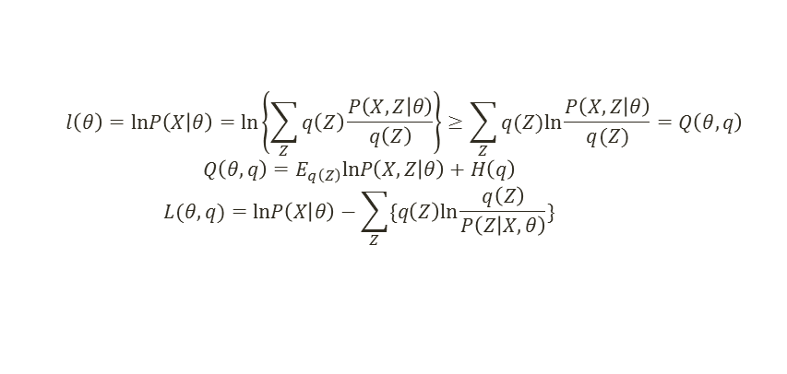
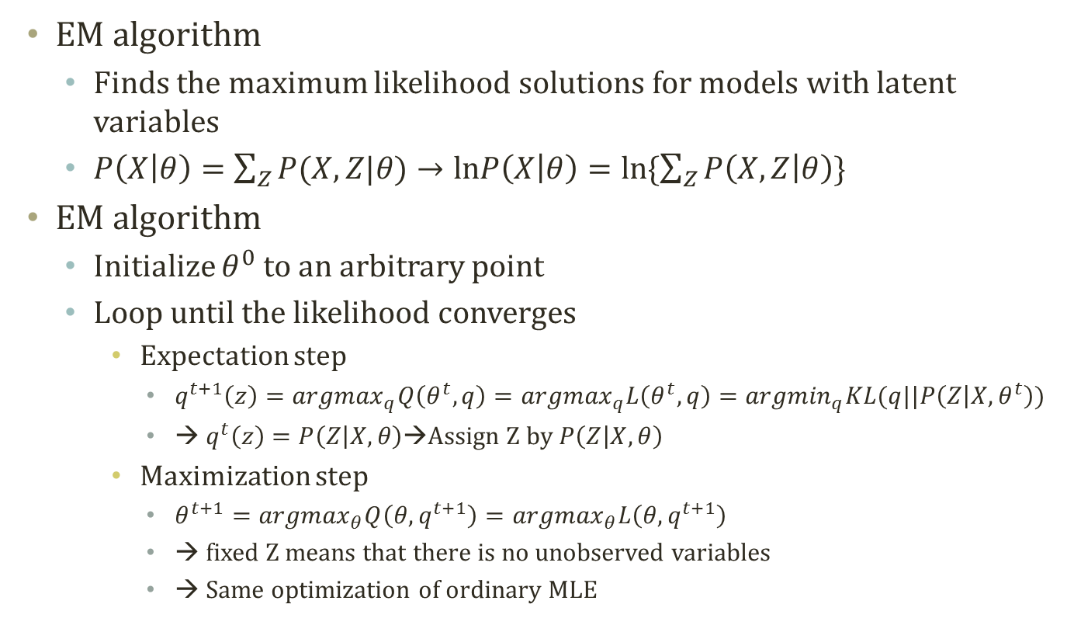
EM Algorithm
$$l\left(θ\right)=lnP\left(X | θ\right)=ln\left\{\sum_{Z}{q\left(Z\right)\frac{P\left(X,Z | θ\right)}{q\left(Z\right)}}\right\}≥\sum_{Z}{q(Z)ln\frac{P\left(X,Z | θ\right)}{q(Z)}}=Q\left(θ,q\right)$$
$$Q\left(θ,q\right)=E_{q\left(Z\right)}lnP\left(X,Z | θ\right)+H\left(q\right)$$
$$L(θ,q)=lnP\left(X | θ\right)−\sum_{Z}{\{q\left(Z\right)ln\frac{q\left(Z\right)}{P\left(Z | X,θ\right)}\}}$$
EM algorithm
Finds the maximum likelihood solutions for models with latent variables
$P\left(X | θ\right)=\sum_{Z}{P(X,Z|θ)}→lnP\left(X | θ\right)=ln\{\sum_{Z}{P\left(X,Z | θ\right)}\}$
EM algorithm
Initialize $θ^{0}$ to an arbitrary point
Loop until the likelihood converges
Expectation step
$q^{t+1}\left(z\right)={argmax}_{q}Q\left(θ^{t},q\right)={argmax}_{q}L\left(θ^{t},q\right)={argmin}_{q}KL(q||P\left(Z | X,θ^{t}\right))$
→ $q^{t}\left(z\right)=P\left(Z | X,θ\right)$→Assign Z by $P\left(Z | X,θ\right)$
Maximization step
$θ^{t+1}={argmax}_{θ}Q\left(θ,q^{t+1}\right)={argmax}_{θ}L\left(θ,q^{t+1}\right)$
→ fixed Z means that there is no unobserved variables
→ Same optimization of ordinary MLE

Slide 31
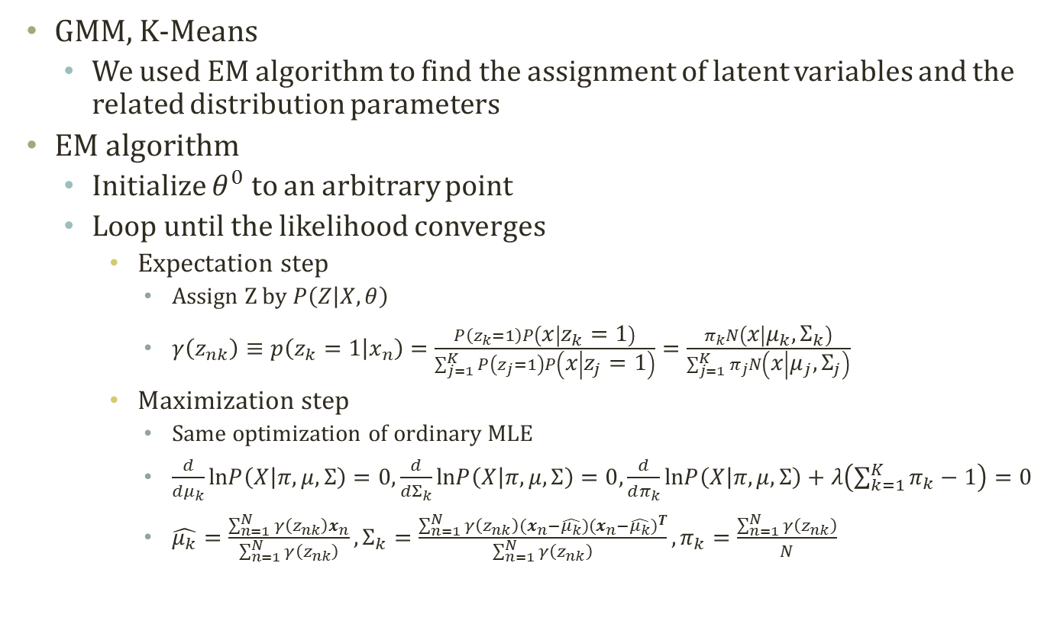
Rethinking GMM Learning Process
GMM, K-Means
We used EM algorithm to find the assignment of latent variables and the related distribution parameters
EM algorithm
Initialize $θ^{0}$ to an arbitrary point
Loop until the likelihood converges
Expectation step
Assign Z by $P\left(Z | X,θ\right)$
$γ\left(z_{nk}\right)≡p\left(z_{k}=1 | x_{n}\right)=\frac{P\left(z_{k}=1\right)P\left(x | z_{k}=1\right)}{\sum_{j=1}^{K}{P\left(z_{j}=1\right)P\left(x | z_{j}=1\right)}}=\frac{π_{k}N\left(x | μ_{k},Σ_{k}\right)}{\sum_{j=1}^{K}{π_{j}N\left(x | μ_{j},Σ_{j}\right)}}$
Maximization step
Same optimization of ordinary MLE
$\frac{d}{dμ_{k}}lnP\left(X | π,μ,Σ\right)=0,\frac{d}{dΣ_{k}}lnP\left(X | π,μ,Σ\right)=0,\frac{d}{dπ_{k}}lnP\left(X | π,μ,Σ\right)+λ\left(\sum_{k=1}^{K}{π_{k}}−1\right)=0$
$\hat{μ_{k}}=\frac{\sum_{n=1}^{N}{γ\left(z_{nk}\right)}x_{n}}{\sum_{n=1}^{N}{γ\left(z_{nk}\right)}},Σ_{k}=\frac{\sum_{n=1}^{N}{γ\left(z_{nk}\right)}(x_{n}−\hat{μ_{k}}){(x_{n}−\hat{μ_{k}})}^{T}}{\sum_{n=1}^{N}{γ\left(z_{nk}\right)}},π_{k}=\frac{\sum_{n=1}^{N}{γ\left(z_{nk}\right)}}{N}$

Slide 32
Further Readings
Bishop Chapter 2 and 9
Murphy Chapter 11

